Slide 1
Sprouted Grains Good Taste, Good Health
Cynthia Harriman
Director of Food & Nutrition Strategies
Oldways and the Whole Grains Council
Oldways and the Whole Grains Council

Slide 2
The Whole Grains Council
Part of U.S.-based non-profit nutrition education organization Oldways
Founded in 2003
Creators of the Whole Grain Stamp, used on more than 9,000 products in 41 countries
Oldways and the Whole Grains Council

Slide 3
Mission of the WGC
To help consumers find whole grains and understand their health benefits
To help the media write compelling and accurate stories about whole grains
To help manufacturers create more and better whole grain products
Oldways and the Whole Grains Council

Slide 4
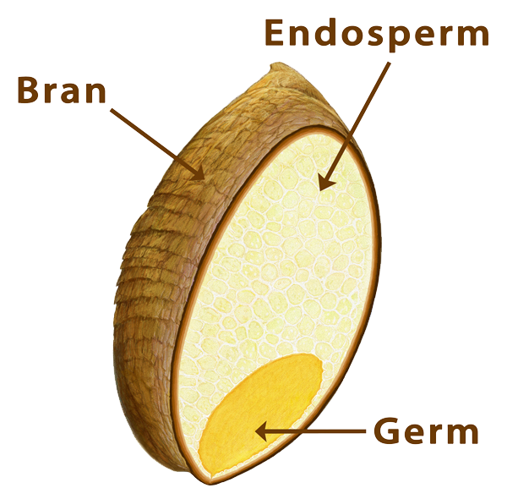
What is a Whole Grain?
A whole grain contains all three of its original edible parts in their original proportions:
• The outer bran layers, rich in fiber and B vitamins
• The nutrient-packed germ, which becomes the new plant
• The starchy endosperm
Oldways and the Whole Grains Council

Slide 5
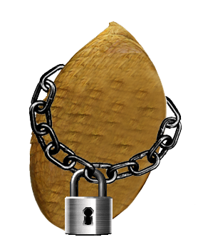
What is a Seed?
Seeds are long-term storage packages, designed to keep their goodness locked inside until conditions are right to grow a new plant.
When sprouting begins, the process “unlocks” many of the grain’s nutrients, making them more available to our bodies.
Oldways and the Whole Grains Council

Slide 6
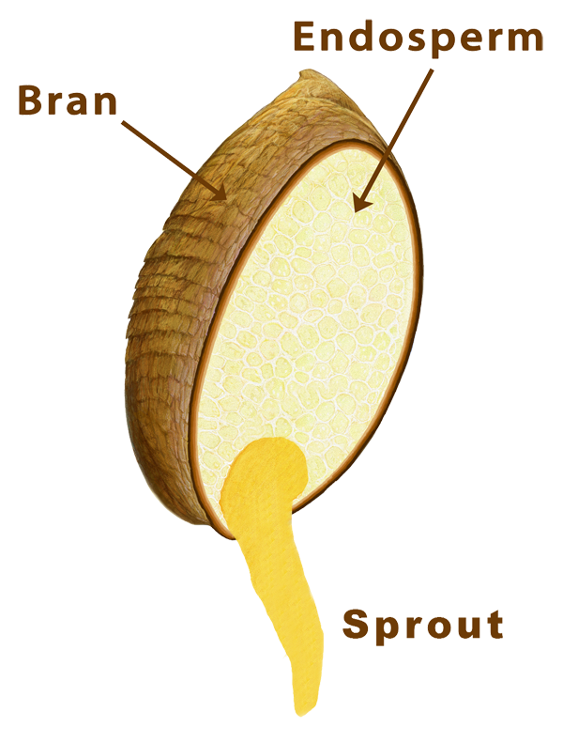
What is a Sprouted Grain?
When a grain kernel – the seed of a wheat plant or other grain – is given just the right temperature and moisture conditions, it begins to sprout.
A sprouted grain has begun to grow into a new plant – but just barely. The new sprout will be shorter than the length of the original grain.
Oldways and the Whole Grains Council

Slide 7
Unlocking a Grain’s Nutrients
Sprouting grains causes many changes including:
• Complex molecules become simpler and easier to digest
• Vitamin C increases
• Folate increases
• Antioxidants increase
• Insoluble fiber decreases
• Soluble fiber increases
• Gluten decreases
… and more!
Oldways and the Whole Grains Council

Slide 8
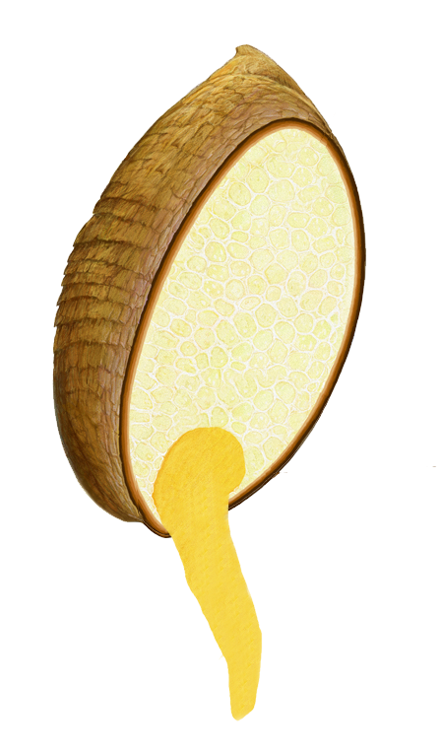
Time to Stop Sprouting!
Sprouting must be carefully controlled.
If conditions are too wet for too long, the sprouted grain can begin to break down and rot.
Even if conditions are just right and the sprout keeps growing, sprouting should be stopped when just a little “tail” appears on the grain. Otherwise, it will eventually become a cereal grass stalk– something humans can’t easily digest.
Oldways and the Whole Grains Council

Slide 9
Wet Mash or Dry Flour?
Companies making sprouted grain products currently use two different approaches – dry and wet – once the grains are sprouted.
Wet Mash. Wet sprouted grains are mashed into a thick purée which is used to make breads, tortillas, muffins and other products often described as “flourless.”
Dry Flour. Grain is sprouted then dried, locking it in its ideal stage. The dry sprouted grains can then be cooked like rice, or ground into sprouted grain flour and used for baking.
Oldways and the Whole Grains Council

Slide 10
Sprouting Increases Nutrients
• Sprouting Enhances Folate in Pita Bread. Egyptian researchers found that sprouting wheat increased folate levels 3- to 4-fold.
Food and Nutrition Research, 2012, Hefni et al.
• Sprouted Wheat Higher in Nutrients. Vietnamese researchers sprouted wheat for 48 hours, and found it was higher in dietary fiber, free amino acids and phenolic compounds than unsprouted wheat.
Journal of the Science of Food & Agriculture, Sep 2011, Hung et al.
• Antioxidant Activity Highest in Sprouted Brown Rice. Scientists comparing antioxidant activity in white rice, brown rice and sprouted brown rice, found sprouted brown rice had the highest antioxidant levels.
Food Chemistry, Nov 2013, Mohdet al.
• Sprouting Millet Makes Some Minerals More Available. Indian scientists sprouted millet and found that iron was 300% more bioaccessible, manganese 17% and calcium was “marginally” more bioaccessible.
Journal of Agriculture & Food Chemistry, July 2010, Platel et al.
Oldways and the Whole Grains Council

Slide 11
Sprouted Grains & Good Health
• Sprouted Wheat Bread Reduces Glycemic Response. Canadian researchers fed white bread, whole grain bread, sourdough bread and sprouted grain bread to overweight males and found that the sprouted grain bread invoked the mildest glycemic response.
Journal of Nutrition and Metabolism, 2012, Mofidi et al.
• Sprouted Brown Rice Fights Diabetes. In a small Japanese study, researchers found that people eating sprouted brown rice had better blood sugar and lipid control than those eating white rice.
Journal of Nutritional Science and Vitaminology, April 2008, Hsu et al.
• Germinated Brown Rice Extracts Inhibit Cancer Cells. Korean researchers sprouted brown rice to increase its gamma-aminobutyric acid (GABA). Higher GABA levels slowed the growth of leukemia cells.
Journal of Medicinal Food, Spring 2004, Oh et al.
Oldways and the Whole Grains Council

Slide 12
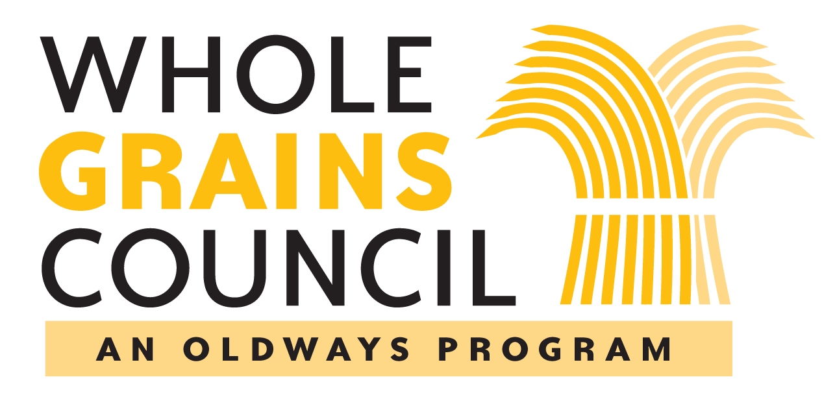
www.WholeGrainsCouncil.org and www.oldwayspt.org
Oldways and the Whole Grains Council

