Slide 1
Developing the Whole Grain Stamp
Cynthia Harriman
Director of Food & Nutrition Strategies
Oldways / Oldways Whole Grains Council
Notes:
The Whole Grain Stamp is a well-known packaging symbol found on more than 11,000 whole grain products in 56 countries, as of September 2017. This is the story of how and why Oldways developed the Whole Grain Stamp to help shoppers find whole grain products.

Slide 2
The Oldways Whole Grains Council
Our mission….
To help consumers find whole grain foods and understand their health benefits
To help manufacturers and restaurants create delicious whole grain foods
To help the media write accurate and compelling stories about whole grains.
Notes:
My name is Cynthia Harriman. In 2003 I started working with Oldways, a nutrition communication nonprofit promoting better health through traditional ways of eating.
Oldways was already well known for creating the Mediterranean Diet Pyramid, and for talking about healthy fats – like olive oil, avocado, nuts, fish – at a time when most people believed the healthiest diet was a totally fat-free diet. Now we had decided our next big project would focus on whole grains, including a packaging symbol to help shoppers identify whole grains. We started the Oldways Whole Grains Council, with three parts to its mission:

Slide 3
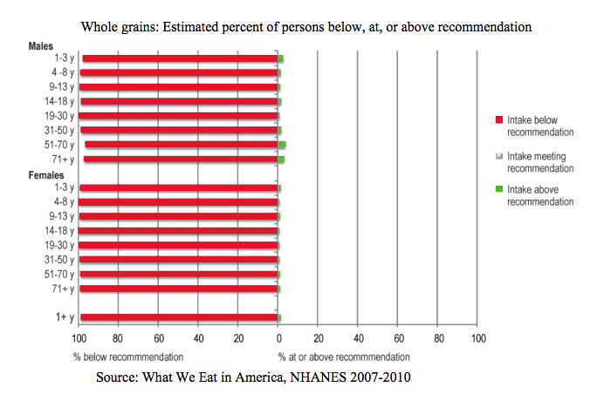
Identify a Need:
No one’s eating enough whole grains
Notes:
We had identified a clear problem: no one is eating enough whole grains. Low carb diets were gaining popularity, and Oldways wanted to play a role in helping people differentiate between healthy and unhealthy carbs, just as we had done with healthy and unhealthy fats during the 1990s.
As you can see by this data from 2007-2010, only a tiny percentage of people have been making at least half their grains whole, as recommended by the Dietary Guidelines for Americans since 2005.

Slide 4
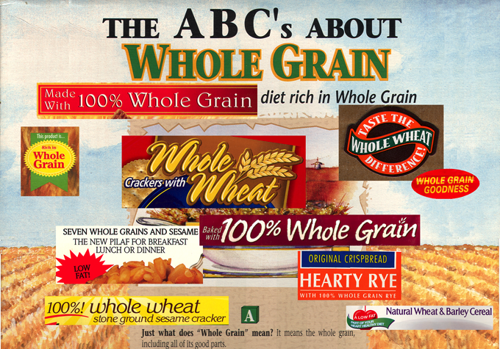
Partly because labels are confusing!
Notes:
One reason people don’t meet their requirement for whole grains is that they’re bewildered in the grocery aisles by confusing claims on packages.
A trust-worthy packaging symbol would help consumers – and would encourage manufacturers to make new whole grain products, because finally there would be a way to “get credit” for them.

Slide 5
CONSUMERS
MANUFACTURERS
How to Meet
Everyone’s Needs???
REGULATORY
Notes:
So what sort of packaging symbol would work? CLICK Whatever it was, it had to work with consumers, by making it really easy for them to identify a food containing a significant amount of whole grain. CLICK Then, it had to work for manufacturers. If you come up with something great but you don’t get any of the food companies on board, you’re dead in the water. A packaging symbol needs to appear on packages, after all.
CLICK It also has to satisfy regulators at both USDA and FDA and be compliant with existing laws. To do this, we decided to keep our symbol simple and have it ONLY talk about the amount of whole grain – no requirements for high fiber, low sugar, or anything else that would pull it over from a content claim to a health claim.

Slide 6
What Will It Stand For?
How much whole grain must the product contain?
What amount would best reinforce Dietary Guidelines recommendations?
Which grains qualify?
What information do we need to get from the manufacturer to certify the product?
Notes:
We pondered at length some of the key questions.
Once we settled some of these questions, we started designing the graphics.

Slide 7
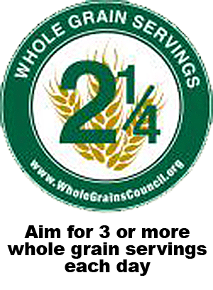
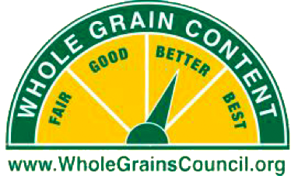
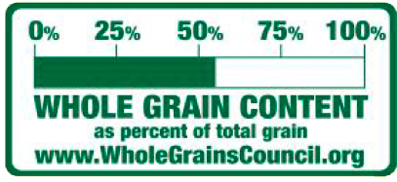
What Will It Look Like?
Notes:
Here are just a few of our many ideas.
• We toyed with servings, but couldn’t use that approach because USDA insists on the the term “ounce equivalents” – a term totally confusing to normal people.
• We went with percent of the grain that’s whole grain, but under FDA rules, if you use percents on your products they are assumed to refer to the percent of all ingredients – not percent of the grain that’s whole grain.
• We played with gauges, which consumers really liked, but couldn’t use that approach because manufacturers balked at using a packaging symbol that says their product is “fair” or “good” instead of The Best.
Would it really be possible to come up with a symbol that worked all around?

Slide 8
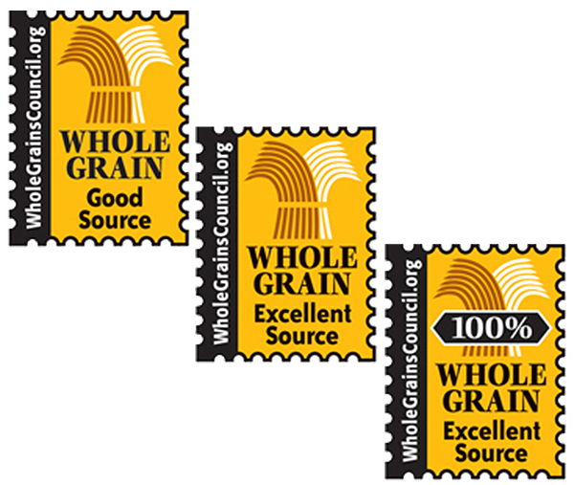
Phase I Whole Grain Stamps
January 2005
“They’re going to help take out the guesswork.”
Notes:
We finally settled on a design that looked like a postage stamp, and checked it out with our 3 groups.
For Consumers – We ran focus groups at supermarkets on the West Coast, East Coast and in the Midwest, and consumers liked it.
For Manufacturers – We showed it to all the companies that had expressed interest in a whole grain packaging symbol and they liked it.
For Regulators – FDA had indicated that it would be supportive of using the same “Good Source” / “Excellent Source” approach used for nutrients.
CLICK We got a big boost just a few months in when the Stamp was featured on the very popular Oprah show. Our plan had been to wait to do consumer promotion until more companies were using the Stamp, but Oprah speeded up our plans! By the end of its first year, more than 450 products were using the Stamp.

Slide 9
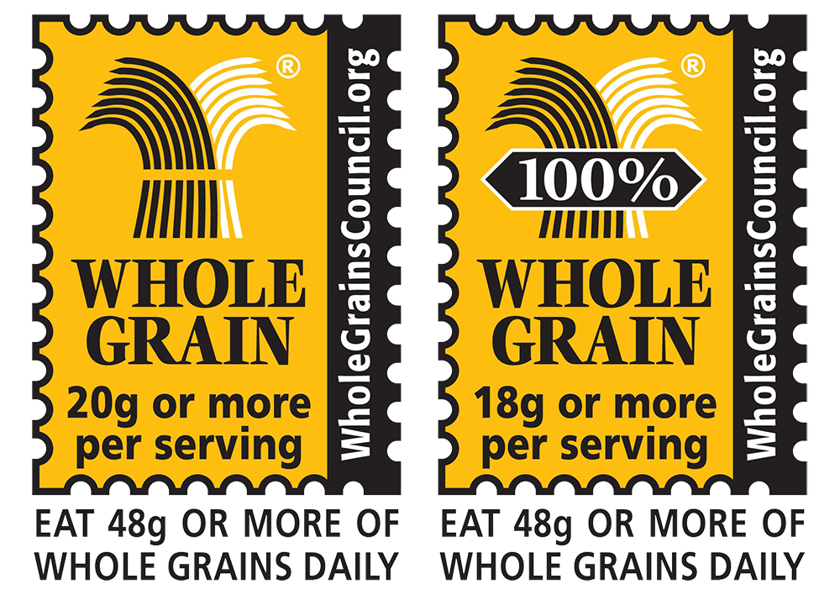
FDA Draft Guidance
February 2006
Notes:
A year into our grand adventure, we hit a roadblock. Due to personnel and policy changes at FDA, the agency decided that it would not, after all, support the use of Good Source and Excellent Source to describe whole grain content. It put out something called a “draft guidance” which – though not legally binding – tells everyone what FDA thinks and therefore, what it might target as “misleading.”
We took a deep breath and started over, using the same basic Stamp graphic – which already had growing brand equity and recognition – and changing what it stood for, to be in accordance with FDA’s Draft Guidance.
CLICK Our new “Phase II” WG Stamp design had just two Stamps instead of 3: The 100% Stamp, shown on the right here, is used for products where all the grain is whole grain, and the Basic Stamp, shown on the left, is for products made with a mix of whole and refined grain. All Stamps clearly state the amount of whole grain in a serving of that product.
Once again we did consumer focus groups, and learned that consumers actually trusted the Stamp MORE when it had a specific gram number on it. Manufacturers needed a great deal of convincing. They were initially very reluctant to transparently state exact grams of whole grain content; but FDA’s clear preference for this approach got them on board.
So in the end what seemed like a heart-stopping disaster turned into a strong improvement in the Whole Grain Stamp program.

Slide 10
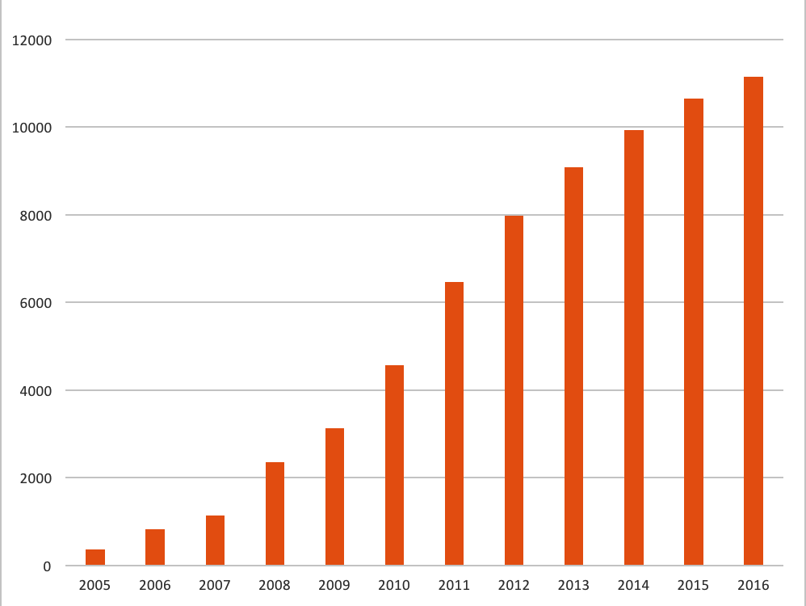
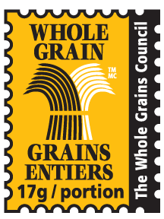
Products Using the
Whole Grain Stamp
Notes:
After that brief setback, use of the Whole Grain Stamp snowballed in the US and beyond. CLICK As the Stamp spread to more and more countries, we introduced new versions for Canada and South America, and then Stamps in Chinese and Arabic. The Whole Grain Stamp is now used on more than 11,000 products in 56 countries.

Slide 11
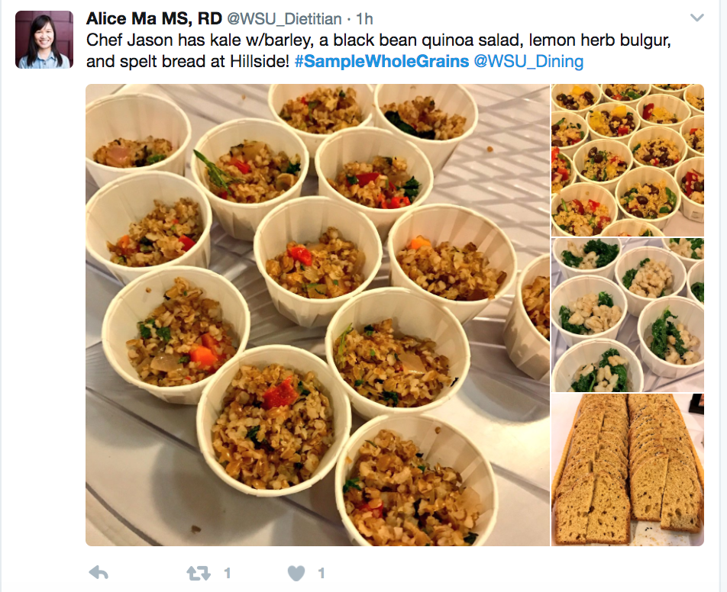
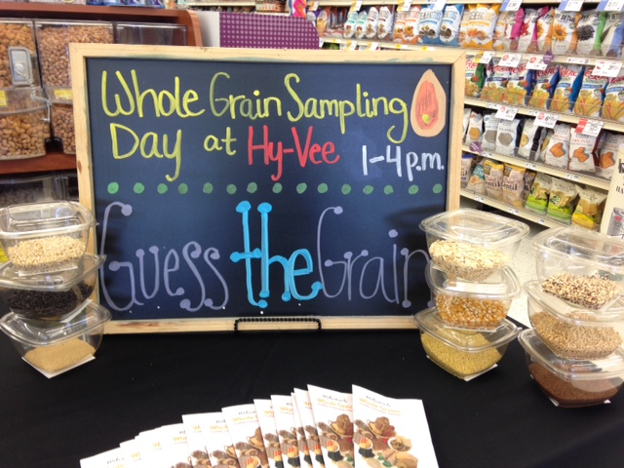
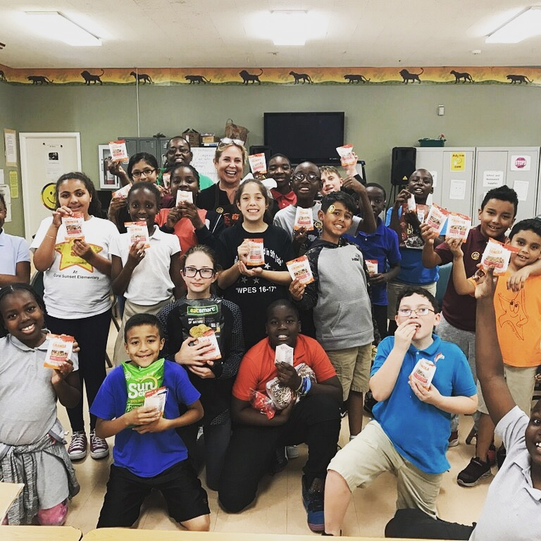
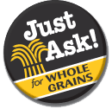
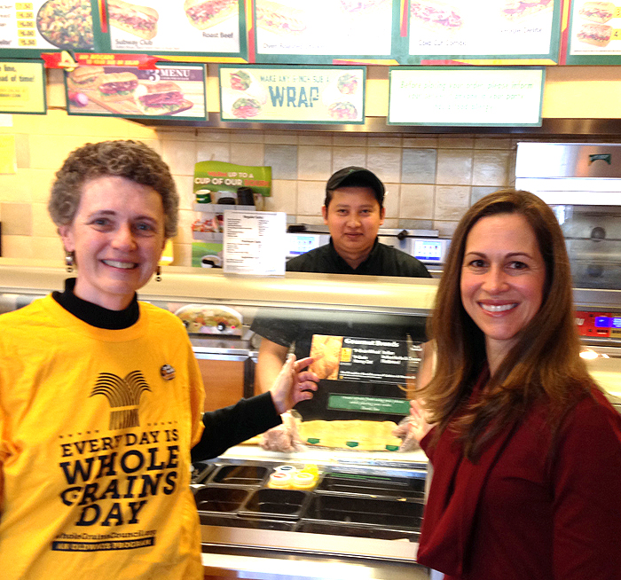
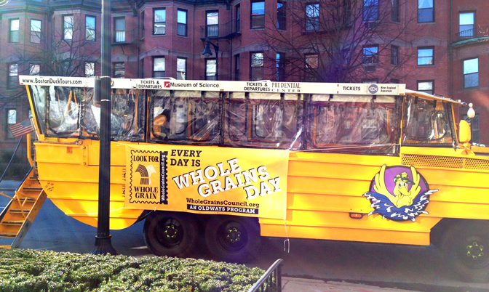
Creative Promotions
and Education
Supermarket
Daycare
University
Fast Food
Everywhere
Notes:
Of course, you can’t just slap a symbol on packaging and go home. We spend a lot of our time working up creative education programs, just a few of which you see here. We work nationwide with universities, supermarkets, fast food outlets, daycare centers and more. We even rented one of Boston’s well-known Duck Boats one year, and drove all over Boston giving away whole grain samples to surprised pedestrians.

Slide 12
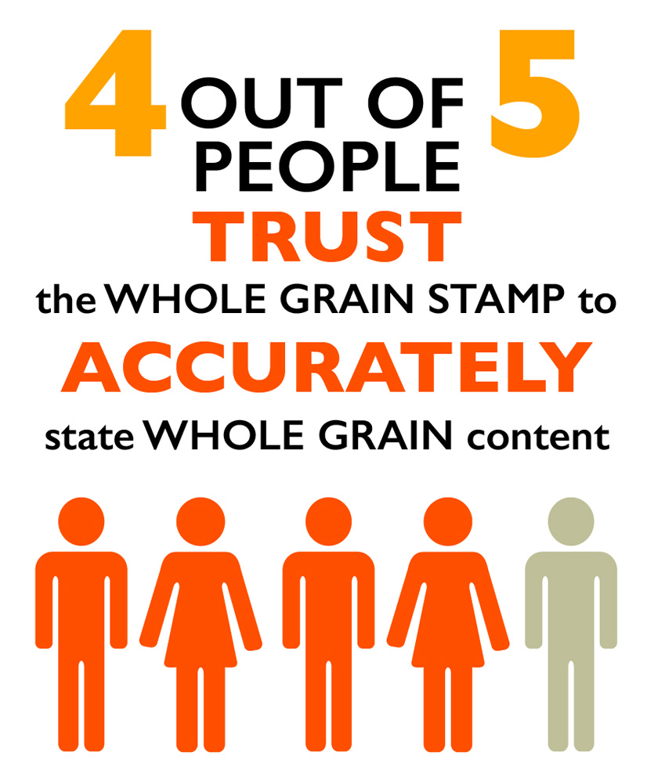
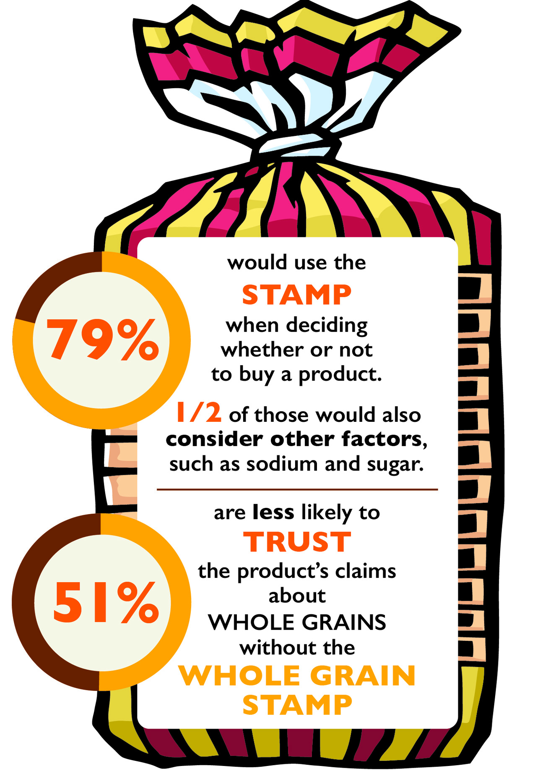
Growing Awareness,
Trust and Impact
consumption
50%
Source: Oldways 2015
Whole Grains Consumer Insights
Survey of 1500 adults
Source: USDA
NHANES 2004-2014
Notes:
It’s gratifying to see the impact of our work. Official USDA data show that whole grain consumption rose 50% from 2005, when the Stamp was introduced, to 2014, although it still falls short of recommendations.
CLICK And a census-representative survey of 1500 adults that we carried out in 2015 showed that the Stamp is widely trusted and used as a key factor in making purchasing decisions.

Slide 13
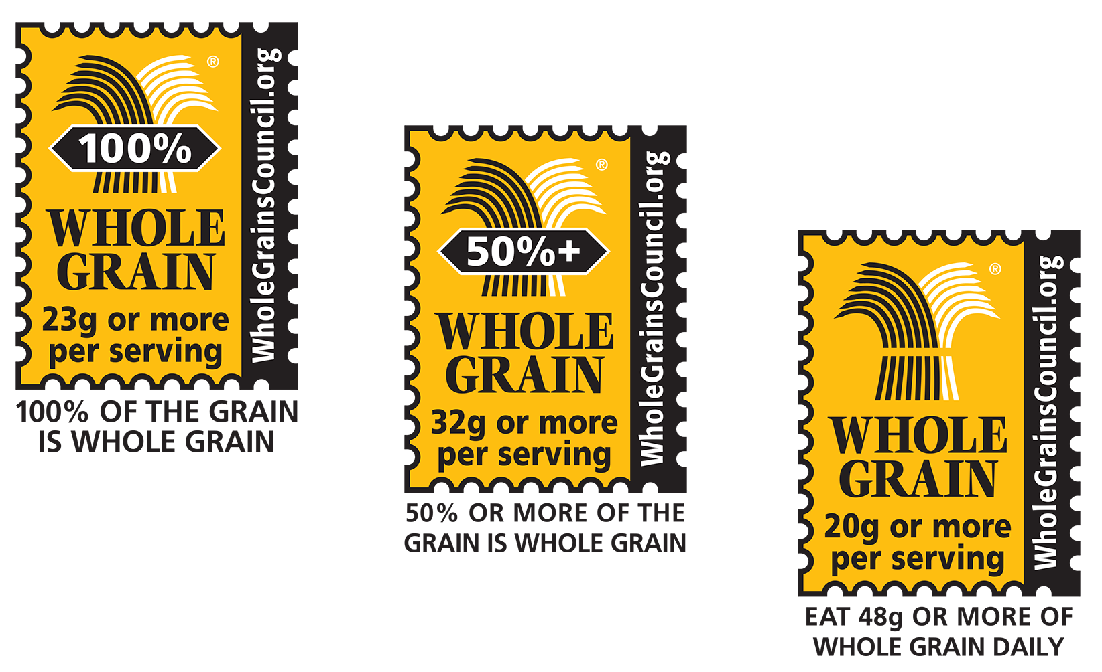
What’s Next?
Notes:
What’s next? We’re always thinking about how we can continue to encourage both manufacturers and consumers to keep climbing up the ladder of whole grain consumption. Early this year, we added a third option to the Whole Grain Stamp family: the 50%+ Stamp, to clearly identify products with more whole grain than refined grain.
Our goal is to make the Basic Stamp obsolete, as products made primarily with whole grain become more and more widely available and accepted. (Today ¾ of products qualify for the 50%+ or 100% Stamp).

Slide 14
Steps for Success
Build a reputation as an organization with worldwide reach and respect.
Identify a crucial nutrition need.
Find a solution that works for all parties concerned.
Spread the word, with creative programming and promotions.
Even after success arrives, keep tweaking and improving everything to continue moving forward.
Notes:
To recap, here are the steps we took, to make the Whole Grain Stamp into a powerful tool that’s improving public health.

Slide 15
Thank You!
Questions: cynthia@oldwayspt.org
www.oldwayspt.org and www.WholeGrainsCouncil.org
Notes:
If you have any questions about whole grains, the Whole Grain Stamp, or traditional ways of eating, please contact me!

